Slide 1


Comparison of Yolo algorithm and faster r-cnn
Team members :
Abdelrahman Atef Mohamed 18p8622 Mostafa Mohamed nageb 1809079
Mustafa Ahmed Allam Attia 1803488

Slide 2
What is yolo ?
YOLO is an abbreviation for the term ‘You Only Look Once’. This is an algorithm that detects and recognizes various objects in a picture (in real-time). Object detection in YOLO is done as a regression problem and provides the class probabilities of the detected images.
YOLO algorithm employs convolutional neural networks (CNN) to detect objects in real-time. As the name suggests, the algorithm requires only a single forward propagation through a neural network to detect objects.
This means that prediction in the entire image is done in a single algorithm run. The CNN is used to predict various class probabilities and bounding boxes simultaneously.
Note: there are major differences between YOLOv3, and older versions occur in terms of speed, precision, and specificity of classes.

Slide 3
Why yolo algoritm ?
Speed: This algorithm improves the speed of detection because it can predict objects in real-time.
High accuracy: YOLO is a predictive technique that provides accurate results with minimal background errors.

Slide 4
How the YOLO algorithm works
YOLO algorithm works using the following three techniques:
Residual blocks
Bounding box regression
Intersection Over Union (IOU)

Slide 5

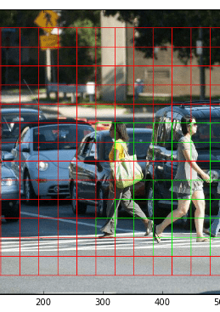
1-Residual blocks
First, the image is divided into various grids. Each grid has a dimension of S x S. The following image shows how an input image is divided into grids.
there are many grid cells of equal dimension. Every grid cell will detect objects that appear within them. For example, if an object center appears within a certain grid cell, then this cell will be responsible for detecting it.

Slide 6
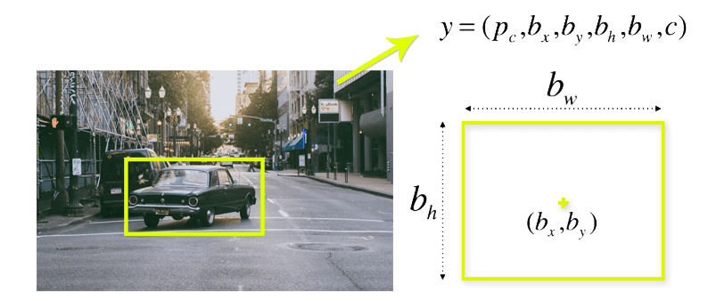
2-Bounding box regression
A bounding box is an outline that highlights an object in an image.
Every bounding box in the image consists of the following attributes:
Width (bw)
Height (bh)
Class (for example, person, car, traffic light, etc.)- This is represented by the letter c.
Bounding box center (bx,by)
The following image shows an example of a bounding box. The bounding box has been represented by a yellow outline.
YOLO uses a single bounding box regression to predict the height, width, center, and class of objects. In the image above, represents the probability of an object appearing in the bounding box.

Slide 7
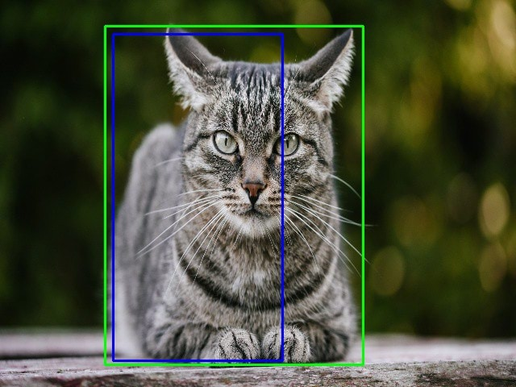
3-Intersection over union (IOU)
Intersection over union (IOU) is a phenomenon in object detection that describes how boxes overlap. YOLO uses IOU to provide an output box that surrounds the objects perfectly.
Each grid cell is responsible for predicting the bounding boxes and their confidence scores. The IOU is equal to 1 if the predicted bounding box is the same as the real box. This mechanism eliminates bounding boxes that are not equal to the real box.
The following image provides a simple example of how IOU works.

Slide 8
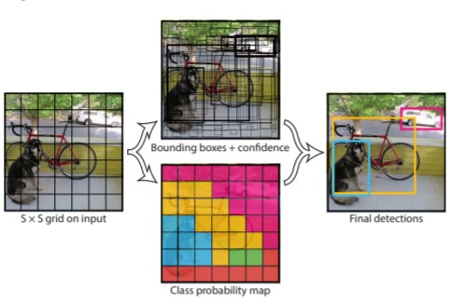
Combination of the three techniques
The following image shows how the three techniques are applied to produce the final detection results.
First, the image is divided into grid cells. Each grid cell forecasts B bounding boxes and provides their confidence scores. The cells predict the class probabilities to establish the class of each object.
For example, we can notice at least three classes of objects: a car, a dog, and a bicycle. All the predictions are made simultaneously using a single convolutional neural network.
Intersection over union ensures that the predicted bounding boxes are equal to the real boxes of the objects. This phenomenon eliminates unnecessary bounding boxes that do not meet the characteristics of the objects (like height and width). The final detection will consist of unique bounding boxes that fit the objects perfectly.
For example, the car is surrounded by the pink bounding box while the bicycle is surrounded by the yellow bounding box. The dog has been highlighted using the blue bounding box.

Slide 9
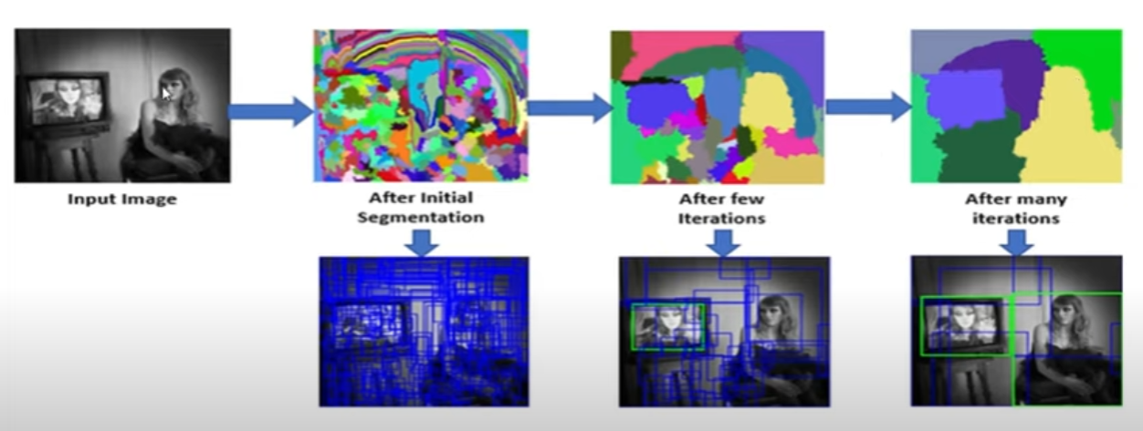
R-cnn
instead of working on a massive number of regions, the RCNN algorithm proposes a bunch of boxes in the image and checks if any of these boxes contain any object. RCNN uses selective search to extract these boxes from an image (these boxes are called regions).
Let’s first understand what selective search is and how it identifies the different regions. There are basically four regions that form an object: varying scales, colors, textures, and enclosure. The selective search identifies these patterns in the image and based on that, proposes various regions. Here is a brief overview of how selective search works:
It first takes an image as input:
Then, it generates initial sub-segmentations so that we have multiple regions from this image:
The technique then combines the similar regions to form a larger region (based on color similarity, texture similarity, size similarity, and shape compatibility):
Finally, these regions then produce the final object locations (Region of Interest).

Slide 10
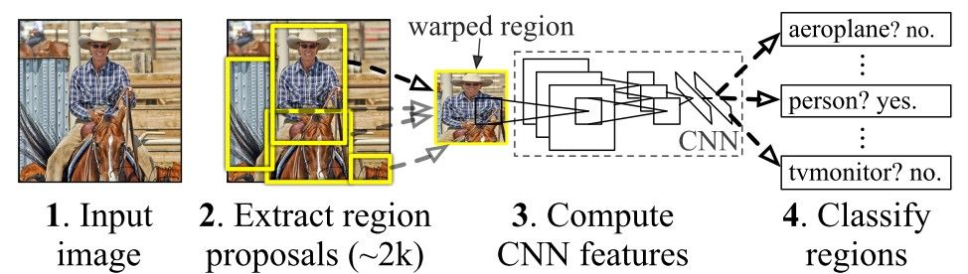
First, an image is taken as an input:
Then, we get the Regions of Interest (ROI) using some proposal method (for example, selective search as seen above):
All these regions are then reshaped as per the input of the CNN, and each region is passed to the ConvNet:
CNN then extracts features for each region and SVMs are used to divide these regions into different classes:
Finally, a bounding box regression (Bbox reg) is used to predict the bounding boxes for each identified region:

Slide 11
Fast r-cnn
What else can we do to reduce the computation time an RCNN algorithm typically takes? Instead of running a CNN 2,000 times per image, we can run it just once per image and get all the regions of interest (regions containing some object).
Let’s break this down into steps to simplify the concept:
As with the earlier technique, we take an image as an input.
This image is passed to a ConvNet which in turn generates the Regions of Interest.
An RoI pooling layer is applied to all of these regions to reshape them as per the input of the ConvNet. Then, each region is passed on to a fully connected network.
A softmax layer is used on top of the fully connected network to output classes. Along with the softmax layer, a linear regression layer is also used parallel to output bounding box coordinates for predicted classes.
This is how Fast RCNN resolves two major issues of RCNN, i.e., passing one instead of 2,000 regions per image to the ConvNet, and using one instead of three different models for extracting features, classification, and generating bounding boxes.

Slide 12
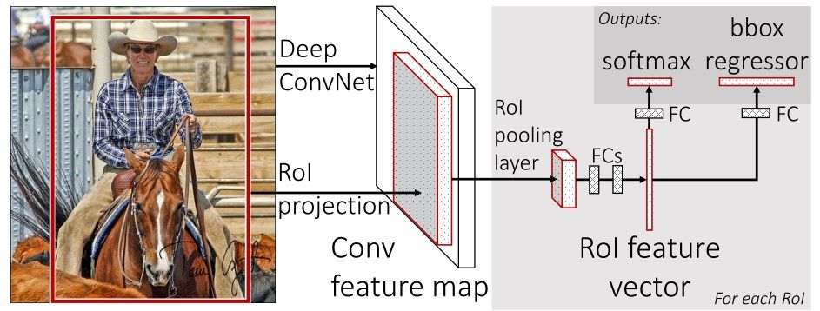

Slide 13
Faster r-cnn
Faster RCNN is the modified version of Fast RCNN. The major difference between them is that Fast RCNN uses the selective search for generating Regions of Interest, while Faster RCNN uses “Region Proposal Network”, aka RPN. RPN takes image feature maps as an input and generates a set of object proposals, each with an objectness score as output.
We take an image as input and pass it to the ConvNet which returns the feature map for that image.
Region proposal network is applied on these feature maps. This returns the object proposals along with their objectness score.
An RoI pooling layer is applied to these proposals to bring down all the proposals to the same size.
Finally, the proposals are passed to a fully connected layer which has a softmax layer and a linear regression layer at its top, to classify and output the bounding boxes for objects

Slide 14
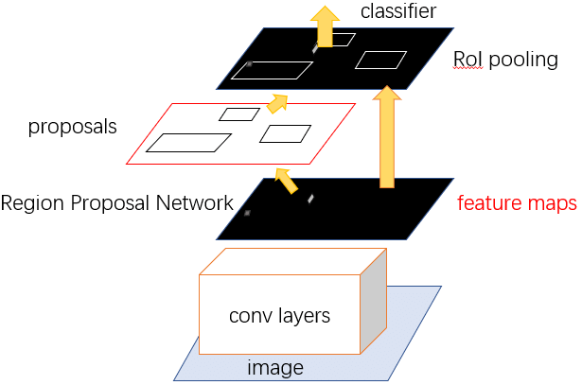
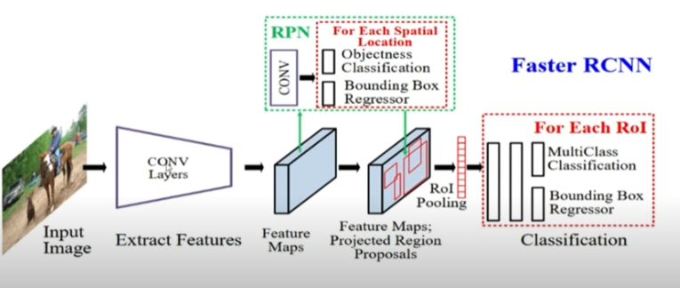

Slide 15
Comparison
YOLO and Faster RCNN both share some similarities. They both uses an anchor box-based network structure, both uses bounding both regression. Things that differs YOLO from Faster RCNN is that it makes classification and bounding box regression at the same time. Judging from the year they were published; it make sense that YOLO wanted a more elegant way to do regression and classification. YOLO however does have its drawback in object detection. YOLO has difficulty detecting objects that are small and close to each other due to only two anchor boxes in a grid predicting only one class of object. It doesn’t generalize well when objects in the image show rare aspects of ratio. Faster RCNN on the other hand, do detect small objects well since it has nine anchors in a single grid, however it fails to do real-time detection with its two-step architecture.

Slide 16
Thank you

